Slide 1




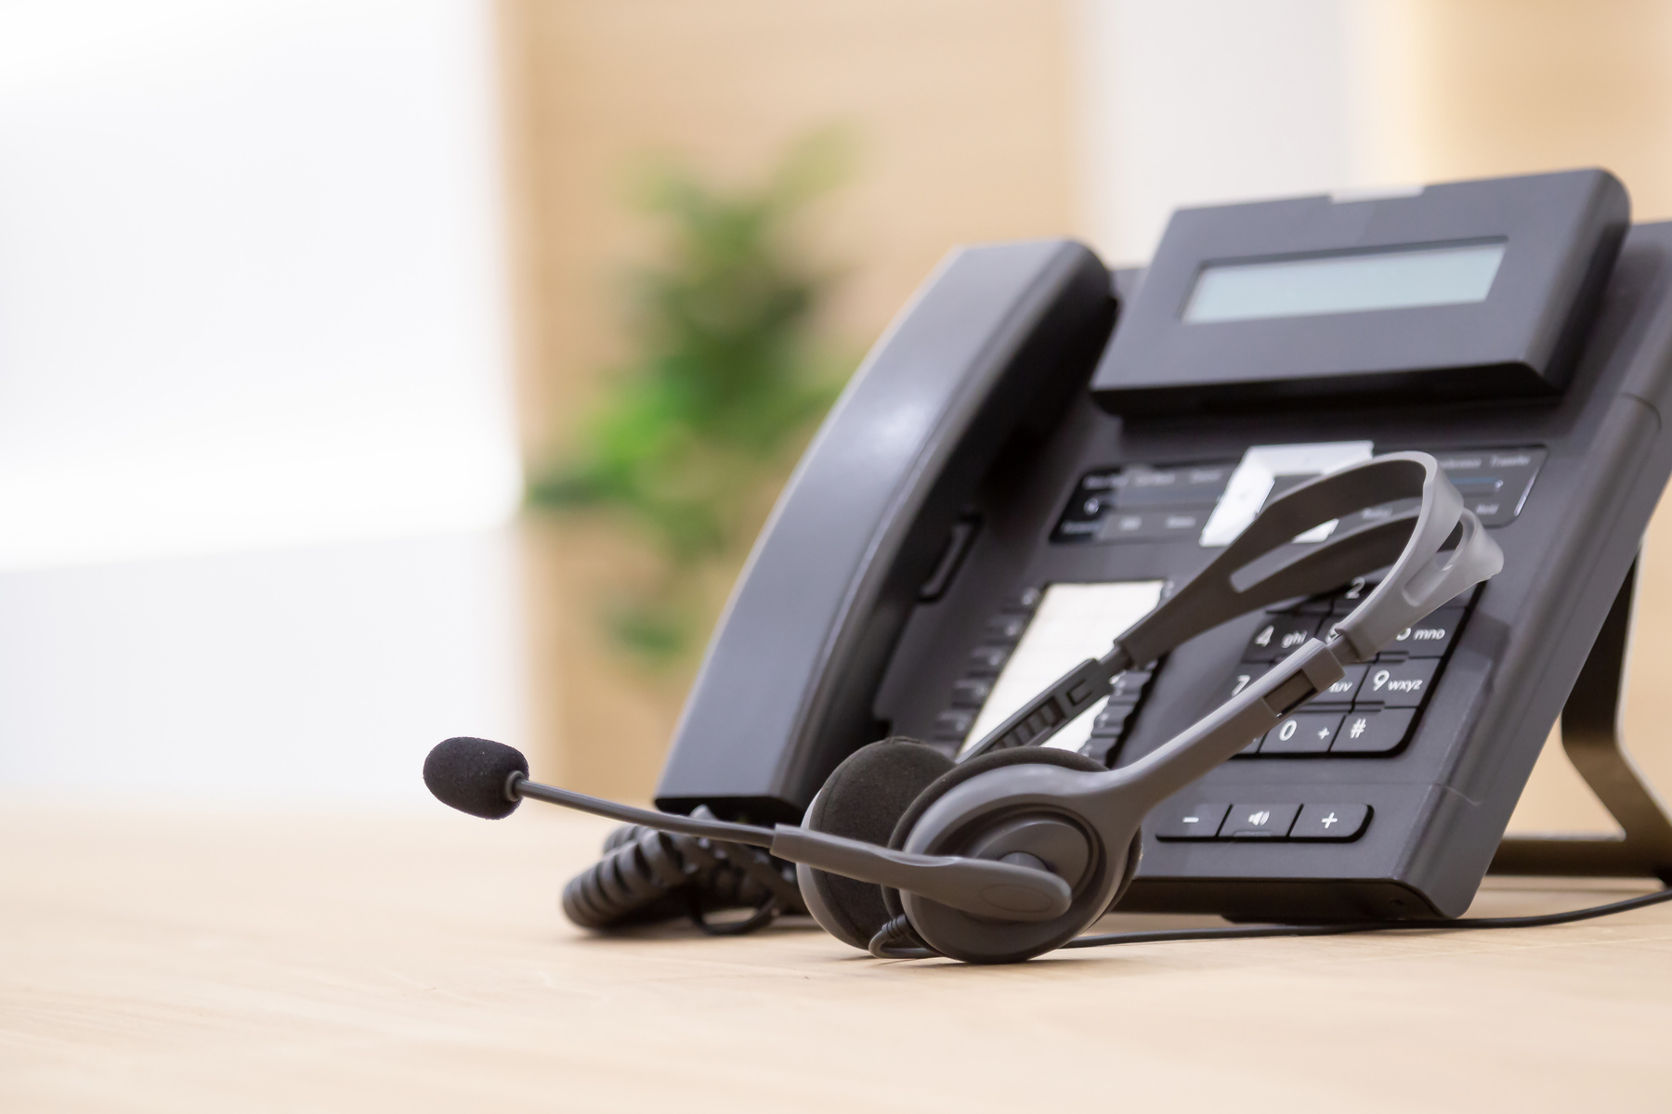
CONFIDENT & EFFECTIVE
CUSTOMER SERVICE REPRESENTATIVE
Communication
Designed by:
Tanekqua Ward

Slide 2



Customer Call Review (Debrief)
Customer Call Review
Scenario:
You’re about to listen to a customer service interaction. As you listen, imagine you’re the Quality Assurance (QA) Coach. As you listen, evaluate the representative’s communication (not the outcome).
What's ONE line that made this call worse?
What would you have said instead?

Slide 3

Lesson Roadmap
Agenda
  The 4 Pillars of Confident Communication
  Activity: Reframe It!
  Tone and Verbal Techniques
  Activity: Tone Challenge
  Difficult Coversations
  Say It Like a Pro
  Wrap-Up & Commitment
By the end of this session, you will be able to:
  Apply the 4 pillars of confident communication (Clarity, Certainty, Calmness, Competence) on live calls
  Reframe negative or uncertain phrases into positive, action-oriented language
  Use tone, active listening, and empathy to build trust and de-escalate tension
  Deliver unwelcome news and say “no” professionally, without sounding defensive
Clarity. Certainty. Calmness. Competence.

Slide 4

The Foundation of Confident Communication
(The 4 C’s - Clarity, Certainty, Calmness, Competence)
Clarity
Certainty
Calmness
Competence
  Speak clearly and at a moderate pace.
  Use simple, straightforward language.
  Avoid jargon, acronyms, and technical terms unless necessary.
  Organize your thoughts before speaking.
  Know your products, services, and policies thoroughly.
  If you don't know something, find the answer.
  Use definitive language when appropriate.
  Avoid "um," "uh," "like," etc.
  Use a steady, even tone of voice.
  Take a breath before responding to difficult questions.
  Don't take customer frustration personally.
  Demonstrate expertise through your knowledge and actions.
  Handle issues timely.

Slide 5

Reframe It
Turn tired, negative phrases into positive, confident language — fast.
HOW IT WORKS:
Breakout into pairs or stay in whole-group to practice.
Display one “tired phrase” at a time (e.g., “That’s not my department”).
You’ll have 30 seconds to say a confident reframe out loud (or type it in chat).
We’ll compare your reframe to the model answer, no wrong answers if it’s positive and action-oriented.
Rotate through 4 - 6 phrases together.
Clarity
Certainty
Calmness
Competence

Slide 6
Reframe It! - Phrase Bank
Try This Instead . . .
Instead of saying . . .
“I don’t know.”
“Great question, let me look into that for you.”

Slide 7
Reframe It! - Phrase Bank
Try This Instead . . .
Instead of saying . . .
“That’s not my department.”
“Let me connect you with the right team.”

Slide 8
Reframe It! - Phrase Bank
Try This Instead . . .
Instead of saying . . .
“I can’t do that.”
“Here’s what I can do for you.”

Slide 9
Reframe It! - Phrase Bank
Try This Instead . . .
Instead of saying . . .
“I understand this is frustrating. Let’s work thorugh it together.”
“You’re angry. Calm down.”

Slide 10
Reframe It! - Phrase Bank
Try This Instead . . .
Instead of saying . . .
“That’s our policy.”
“Here’s why, and here’s what we CAN do. . .”

Slide 11
Reframe It! - Phrase Bank
Try This Instead . . .
Instead of saying . . .
“For future reference . . .”
“You did this wrong. You should have . . .”

Slide 12
“Smile while you speak”
It naturally makes your voice sound warmer and more welcoming — customers can hear a smile, even on a call.
Monitor Your Tone
Tone Tips:
Your tone conveys as much as your words.
A confident, professional tone includes:
Tone Tips:
Warmth & friendliness
  Vary your pitch
  Avoid sounding robotic
  Control your pace
  Match energy *
*(Be enthusiastic celbrating a win, calm when addressing a concern)
Energy & enthusiasm (not over-the-top)
Professionalism & respect
Empathy & understanding
Confidence & authority

Slide 13


Tone Challenge
Same line. Three ways. Hear the difference tone makes.
Personalized Interactions
Your Phrase:
“I understand your frustration, and I’m here to help.”
Consistent Service Quality
Using the given phrase, take turns and say it three of the following ways:
-Flat and Robotic
-Over the top, Enthusiastic
-Warm & Confident (The real you)
Debrief Question:
Which delivery built the most trust, and why?

Slide 14


Active Listening & Empathy
Great communication starts with understanding before responding.
Actively Listen
  Let customers finish speaking.
  Paraphrase key points.
  Ask clarifying questions.
  Take notes.
Show Empathy
  “I understand how frustrating that must be.”
  “Thank you for bringing this to our attention.”
  “Let me see what I can do.”
Scenario Practice: How would you respond to the scenario below?
“I’ve been transferred three times and nobody has helped me.”

Slide 15


When Conversations Get Difficult
Customer:
“I don’t care what your policy says!”
What emotion do you hear?
  Angry
  Frustrated
  Fed up
  Confused
  Disappointed
Remember:
  Stay calm - don’t match negative emotion.
  Listen completely before responding
  Acknowledge the emotion before explaining the solution
  Focus on what you can do, not just what you can’t
  Keep the conversation moving forward

Slide 16

Delivering Difficult News with Confidence
When delivering difficult news . . .
Customer:
“I paid for this course, and I want a refund. don’t care what your policy says!”
Lead with empathy before explaining the policy.
Be direct and transparent.
CSR:
“I understand why you’re disappointed, and I can see why you’d want a different outcome. Our refund policy allows refunds within the first 30 days, so I’m not able to process a refund for this course today. What I can do is review your account with you and see what options are available, such as transferring to another course, accessing available resources, or connecting you with the appropriate team if another solution applies. My goal is to help you find the best path forward . . . “
Explain the reason behind the decision.
Offer the best available next step .
Focus on what you can do.

Slide 17
Saying “No” Well
The goal isn’t to avoid saying “no”. . . it’s to deliver it with empathy and confidence.
Stay Grounded
Focus on Solutions
Stay calm (don’t match customer’s emotion.)
Explain what you can do.
Listen without interrupting.
Provide context behind the decision.
Acknowledge the customer’s concern.
Offer the best available option or next step.
Keep your tone steady and respectful.
End with a supportive next step.

Slide 18
Say It Like a Pro
Use everything you’ve learned to respond with confidence.
HOW IT WORKS:
  A customer scenario will display.
  Think about how you would respond as the CSR.
  Be prepared to share your response aloud or in the chat.
  As a group, we’ll discuss what worked well and identify opportunities to strengthen the response.
Clarity
Certainty
Calmness
Competence

Slide 19





Say It Like a Pro
Use everything you’ve learned to respond with confidence.
Scenario 1
Scenario 2
Scenario 3
Scenario 3
Refund Request
Customer purchased a course several months ago and is requesting a refund, but the request falls outside the refund policy.
Multiple Transfers
Customer has already been transferred more than once and is frustrated about having to explain the situation again.
Course Access
Customer says they purchased a course but can’t access it before an upcoming exam and wants an immediate solution.
Customer:
“I paid for this course, and I want my money back. I don’t care what the policy says.”
Customer:
“I’ve explained this three times already. I understand this isn’t your department but this is the number I have. Do not transfer me again.”
Customer:
“My exam is tomorrow, and I still can’t access my course. SOMEONE NEEDS TO FIX THIS TODAY!”
Clarity
Certainty
Calmness
Competence

Slide 20
Key Takeaways
Remember . . .
Listen first, then respond with empathy.
Use positive, solution-focused language.
Be clear, confident, and transparent when explaining policies.
Focus on what you can do.
Every interaction is an opportunity to build trust and create a positive customer experience.
Confident communication isn’t about having every answer. It’s about helping every customer feel heard, respected, and supported thoroughout their journey.

